Slide 1

Verilog to System Verilog
Prashanth Srinivasa Machavaram ☺
NCD Baseband Hardware Team, LSI India

Slide 2
Agenda
Background
Verilog Limitations
System Verilog
Test bench Features
Data types
Classes
Interfaces and Virtual interfaces
Arrays and methods
Randomization
Communication/Inter-process communication
Direct Programming Interface
Design Features
Assertions
Summary

Slide 3
Background
Complexity of SoC design and verification

Slide 4
Verilog Limitations
module testbench (input clk, output rst, output w_r_en,
output [31:0] addr, output [31:0] wdata, input rdata);
task reset;
//drive reset
endtask
task write;
input [31:0] ad, dta;
//Drive address, control and data
endtask
task read;
input [31:0] ad;
output [31:0] dta;
//Drive addr/control and sample data
endtask
task do_write_read;
input [31:0] ad;
output [31:0] value;
write('h12345678, 'habab_cdcd);
read('h12345678, value);
endtask
endmodule
module test_top();
reg clk;
design d(clk, ...);
testbench tb(clk, ....);
//Generate clock
endmodule
module test1;
test_top top();
reg [31:0] data;
initial begin
top.reset();
top.write('h10000000, $random);
top.read('h10000000, data);
top.do_write_read();
end
endmodule

Slide 5
Verilog Limitations
No/limited randomization features
Only $random
Cannot have random sequences easily
Limited Reusability
Cannot reuse the same BFMs/transactors for all tests (error injection, change in the behavior, etc)
Cannot have layered test bench, for reuse across projects
Array limitation – only fixed arrays
Large arrays consume large runtime memory (causing huge initial loading time)
No Functional coverage
No Assertions

Slide 6
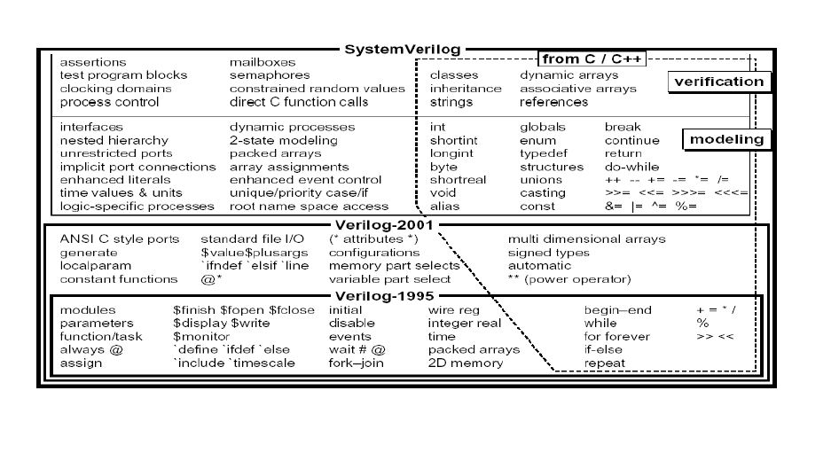
System Verilog – Superset of Verilog 2001

Slide 7
System Verilog
Test bench Features
Data types
Classes
Virtual interfaces
Arrays and methods
Randomization
Synchronization features
Direct Programming Interface
Design Features
Interface, always_ff, always_comb, always_latch, etc
Assertions

Slide 8
System Verilog – Additional Data types
2-state variables – int, bit
Lesser memory foot print
Enum
Good for debugging
Eg: typedef enum bit[1:0] {READ=0, WRITE=1} my_kind_t;
Structures & Unions
Similar to C
Classes
Others (logic, shortint, longint, etc)

Slide 9
System Verilog – Classes
Created and destroyed dynamically
Can have methods (tasks and functions)
Can have random/non-random variables
Data hiding
Inheritance
Polymorphism
Can be Parameterized

Slide 10
System Verilog – Classes (Construction & Destruction)
module testbench (input clk, output rst, output w_r_en,
output [31:0] addr, output [31:0] wdata, input rdata);
task reset;
//drive reset
endtask
task my_random(transaction tr);
if (tr.kind == transaction::READ) read(tr.addr, tr.data..);
if (tr.kind == transaction::WRITE) write(tr.addr, tr.data..);
endtask
task write;
input [31:0] ad, dta;
//Drive address, control and data
endtask
task read;
input [31:0] ad;
output [31:0] dta;
//Drive addr/control and sample data
endtask
endmodule
class transaction;
typedef enum bit {READ=0, WRITE=1} kind_t;
rand bit [31:0] addr;
rand bit [31:0] data;
rand kind_t kind;
local bit value;
endclass
module test1;
test_top top();
reg [31:0] data;
initial begin
top.reset();
for (int i=0; i<100; i++) begin
transaction tr = new;
tr.randomize();
top.tb.my_random(tr);
tr = null;
end
end
endmodule
Creation of object
Destruction of the object (optional)

Slide 11
System Verilog – Classes (Construction & Destruction)
transaction tr;
tr = new();
tr = null;
tr (int)
addr
data
kind
value

Slide 12
System Verilog – Classes (Methods and data hiding)
class transaction;
typedef enum bit {READ=0, WRITE=1} kind_t;
rand bit [31:0] addr;
rand bit [31:0] data;
rand kind_t kind;
function new();
$display(“This is the constructor”);
endfunction
virtual function bit [4:0] calculate_ecc();
bit [4:0] ecc;
//calculate ecc value
return (ecc);
endfunction
endclass
Variables and methods can be declared public, local or protected
Constructor method gets executed automatically when the object is initialized
Keep public methods virtual
Keep the public methods virtual

Slide 13
System Verilog – Classes (Scope resolution)
class transaction;
typedef enum bit {READ=0, WRITE=1} kind_t;
rand bit [31:0] addr;
rand bit [31:0] data;
rand kind_t kind;
bit config_val;
function new(bit config_val);
int addr = 5;
this.config_val = config_val;
this.addr = 10;
endfunction
endclass
Local scope has the higher priority.
this keyword is required to resolve the scope conflict

Slide 14
System Verilog – Classes (Inheritance & Polymorphism)
class transaction;
typedef enum bit {READ=0, WRITE=1} kind_t;
rand bit [31:0] addr;
rand bit [31:0] data;
rand kind_t kind;
virtual function bit [4:0] calculate_ecc();
bit [4:0] ecc;
//calculate ecc value
return (ecc);
endfunction
endclass
class custom_transaction extends transaction;
bit good_cfg;
constraint cst_addr {
if (good_cfg) { addr inside {[0:100]}; }
else { addr inside {[1000:100000]};}
}
function new(bit cfg_val);
super.new();
this.good_cfg = cfg_val;
endfunction
virtual function bit [4:0] calculate_ecc();
bit [4:0] ecc;
if (this.good_cfg) return super.calculate_ecc();
else return (0);
endfunction
endclass
Optional if no arguments
Derived class extends base class and adds its functionality
Base class method can be re-written
super.method() can be used to call the base class method

Slide 15
System Verilog – Classes (Inheritance & Polymorphism)
module testbench (input clk, output rst, output w_r_en,
output [31:0] addr, output [31:0] wdata, input rdata);
task reset;
//drive reset
endtask
task my_random(transaction tr);
if (tr.kind == transaction::READ) read(tr.addr, tr.data..);
if (tr.kind == transaction::WRITE) write(tr.addr, tr.data..);
endtask
task write;
input [31:0] ad, dta;
//Drive address, control, data, ecc, etc
endtask
task read;
input [31:0] ad;
output [31:0] dta;
//Drive addr/control and sample data
endtask
endmodule
module test1;
test_top top();
reg [31:0] data;
initial begin
top.reset();
for (int i=0; i<100; i++) begin
custom_transaction tr = new(0);
tr.randomize();
top.tb.my_random(tr);
end
end
endmodule
Creation of derived object
Assigning derived handle to base handle is valid, But not the other way

Slide 16
System Verilog – Classes (Inheritance & Polymorphism)
transaction tr;
custom_transaction ctr1, ctr2;
tr = new;
ctr1 = new;
ctr2 = new;
ctr2 = tr; //Causes compile error
tr = ctr1;
ctr2 = tr; //Logically correct,
//but still compiler gives error
$cast(ctr2, tr);
tr
ctr1
ctr2
addr
addr
addr
data
data
data
kind
kind
kind
g_cfg
g_cfg

Slide 17
System Verilog – Classes (Inheritance & Polymorphism)
class transaction;
typedef enum bit {READ=0, WRITE=1} kind_t;
rand bit [31:0] addr;
rand bit [31:0] data;
rand kind_t kind;
virtual function transaction copy();
transaction tr = new;
tr.addr = this.addr;
……
return (tr);
endfunction
endclass
class custom_transaction;
bit good_cfg;
virtual function transaction copy();
custom_transaction tr = new();
tr.addr = this.addr;
….
tr.good_cfg = this.good_cfg;
return(tr);
endfunction
endclass
custom_transaction ctr1 = new;
custom_transaction ctr2 = ctr1.copy();
$cast(ctr2, ctr1.copy());
Compiler gives error

Slide 18
System Verilog – Interface
Interface is a collection of related signals
Reduces effort
Avoids connecting to each signal during module integration
Can have tasks/functions and assertions that can be reused.
Interfaces are synthesizable
Provision to define the direction of the signals
BLK1
BLK2
BLK1
BLK2

Slide 19
System Verilog – Interface (modport)
interface intf(input bit clk);
wire rst;
wire w_r_en;
wire [31:0] addr;
wire [31:0] wdata;
wire [31:0] rdata;
modport mst(output w_r_en, output addr, output wdata, output w_r_en, input rdata, input clk);
modport slv(input w_r_en, input addr, input wdata, input w_r_en, output rdata, input clk);
endinterface
module testbench (intf .mst iport);
task reset;
//drive reset
endtask
task write;
input [31:0] ad, dta;
//Drive address, control and data
@(posedge iport.clk);
iport.addr <= ad;
iport.data <= dta;
……
endtask
task read;
input [31:0] ad;
output [31:0] dta;
//Drive addr/control and sample data
endtask
endmodule
Modport contains direction
module test_top();
reg clk;
intf itf(clk);
design d(itf.slv);
testbench tb(itf.mst);
endmodule

Slide 20
System Verilog – Interface (clocking block)
interface intf(input bit clk);
wire rst;
wire w_r_en;
wire [31:0] addr;
wire [31:0] wdata;
wire [31:0] rdata;
clocking cb @(posedge clk);
default input #1 output #1;
output w_r_en;
output addr;
output wdata;
input rdata;
endclocking
modport mst(clocking cb);
modport slv(input w_r_en, input addr, input wdata, output rdata, input clk);
endinterface
module testbench (intf .mst iport);
task reset;
//drive reset
endtask
task write;
input [31:0] ad, dta;
//Drive address, control and data
iport.cb.addr <= ad;
iport.cb.data <= dta;
……
endtask
task read;
input [31:0] ad;
output [31:0] dta;
//Drive addr/control and sample data
endtask
endmodule
Clocking block provides synchronization with skews

Slide 21
System Verilog – Virtual Interface
Virtual interface is the way to access interface inside class
Virtual interface is like a pointer which points to the actual interface
class testbench;
virtual intf.mst iport;
function new(virtual intf.mst iport);
this.iport = iport;
endfunction
virtual task write(input [31:0] ad, dta);
//Drive address, control and data
iport.cb.addr <= ad;
iport.cb.data <= dta;
……
endtask
virtual task read(input [31:0] ad. output [31:0] dta;
//Drive addr/control and sample data
endtask
endclass
module test_top();
reg clk;
intf itf(clk);
design d(itf.slv);
testbench tb;
initial begin
tb = new(itf.mst);
end
endmodule
Virtual interface is being initialized by passing actual interface

Slide 22
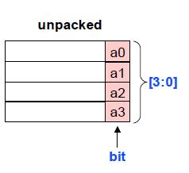

System Verilog – Arrays
Unpacked Arrays
Similar to the Verilog-2001 style
Includes event type and all System Verilog types
Access includes slices of array and entire array
Each element stored independent from others
bit a [3:0]; // unpacked array of bits
Packed Arrays
Only bit-level types (reg, wire, logic, bit), or other packed types
Multiple dimensions allowed
Access whole array, bit/part selects, or slices
Entire array stored as contiguous bits (like a Verilog vector)
bit [3:0] b; // packed array of bits

Slide 23
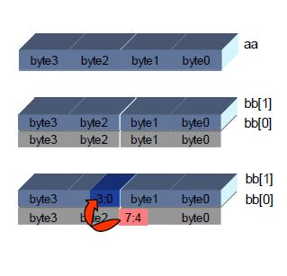
System Verilog – Multi Dimensional Arrays
}
}
bit [a:b] [n:m] [p:q] mem [ t:u] [v:w] [x:y];
Packed 4-byte variable
bit [3:0] [7:0] aa ;
Array of 2 packed 4-byte variables
bit [3:0] [7:0] bb [1:0] ;
Nibble copy
bb[1][2][3:0] = bb[0][1][7:4];
}
Unit
Packed
Unpacked

Slide 24
System Verilog – Dynamic Arrays
Powerful data type for modeling.
The size of the array initialized at runtime using the construction function new.
Efficient use of the memory as per the runtime requirements.
Syntax :
<Data_Type> <NAME> [ ];
bit [3:0] my_nibble[ ]; // Dynamic array of 4-bit vectors
integer memry[ ]; // Dynamic array of integers
int data_array[ ]; // Declare a dynamic array
data_array = new[256]; // Create a 256-element array
int addr = new[100]; // Create a 100-element array
addr = new[200](addr); // Create a 200-element array by preserving previous
// values in lower 100 addresses

Slide 25
System Verilog – Dynamic Array Methods
size() – Returns the current size of the array.
int array_size;
int data_array = new[100];
array_size = data_array.size(); // returns 100
delete() – Empties the array contents and size set to zero
data_array.delete();
array_size = data_array.size() ; // returns zero

Slide 26
System Verilog – Associative Arrays
Powerful data type for modeling SPARSE Memories and CAMs ( indexed Memories).
Efficient use of the memory as it is not required to allocate complete memory. Useful in modeling memories whose size is huge or unpredictable.
Memory Elements can be added and removed individually inside the array.
Pre-defined methods for array accessing.
num(), delete(), exists(), first(), last(), next(), prev()
Syntax :
<Data_Type> <ARRAY_NAME> [ index_data_type];
Example:
bit [7:0] age [string]; // associative array of 8-bit vectors, indexed by string type
bit [31:0] mem_array[longint] // modelling a sparse memory
age [“tom”] = 21;
age [“joe”] = 32;
$display(“Tom is %d years of age ”, age[tom], “[%d ages in database]”, age.num());
mem_array[64’h0000_000A_FFFF_AAAA] = 32’h0000_AAAA;

Slide 27
System Verilog – Queues
A queue is a variable sized array of any data type.
System Verilog queue is an ideal data type to model queues, stacks using the predefined methods.
Syntax :
<Data_Type> <ARRAY_NAME> [ $];
Example:
int fifo[$]; // int type fifo
bit [3:0] nibble[$] ; // nibble list
int size;
………………
………………
size = nibble.$num; //returns size of the list array.
nibble = {} ; // clear the list array
nibble = { nibble, 4’h2} ; // add element to right end
nibble = {4’hf, nibble}; // add element to left end

Slide 28
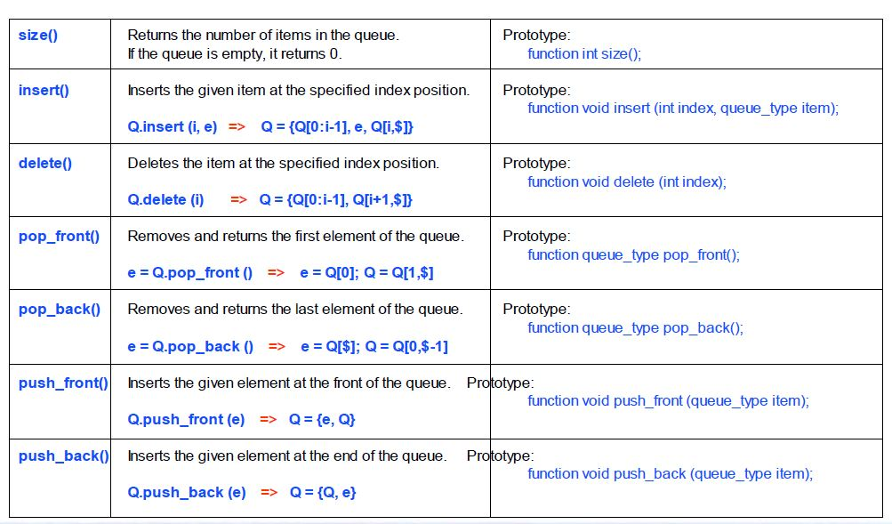
System Verilog – Queues Methods

Slide 29
System Verilog – Randomization
class transaction;
typedef enum bit {READ=0, WRITE=1} kind_t;
rand bit [31:0] addr;
rand bit [31:0] data;
rand kind_t kind;
bit config_val;
constraint my_cst {
addr > 0;
addr <= ‘habcd_1234;
}
function pre_randomize();
$display(“This is pre-randomize”);
endfunction
function post_randomize();
$display(“This is post-randomize”);
endfunction
endclass
Pseudo-random values get generated with every object.randomize() call.
for (int i=0; i<100; i++) begin
transaction tr = new();
tr.randomize();
$display(“Addr=0x%x, Data=0x%x, kind=%s”,
tr.addr, tr.data, tr.kind.name);
end
end

Slide 30
System Verilog – Randomization
class custom_transaction extends transaction;
constraint custom_cst {
(kind == READ) -> addr inside {[32’h1000:32’h2000]};
(kind == WRITE) -> addr inside {32’h500, 32’h2000};
addr != 32’h500;
addr != 32’h2000;
kind != READ;
}
endclass
Constraints can be conditional
Ranges and required values can be specified in constraints
Causes constraint solver error
for (int i=0; i<100; i++) begin
custom_transaction tr = new();
tr.randomize();
$display(“Addr=0x%x, Data=0x%x, kind=%s”, tr.addr, tr.data, tr.kind.name);
end
end

Slide 31
System Verilog – Randomization
class Generator;
rand int val_array[];
rand transaction obj_array[$];
constraint custom_cst {
val_array.size() == 10;
foreach (val_array[i]) {
(i==0) -> val_array[i] == 5;
(i !=0) -> val_array[i] = val_array[i-1] + 1;
}
foreach (obj_array[i]) {
(i==0) -> obj_array[i].kind == WRITE;
(i !=0) -> obj_array[i].kind != obj_array[i-1].kind;
}
}
function new();
for (int i=0; i<2; i++) begin
transaction tr = new;
obj_array.push_back(tr);
end
endfunction
endclass
foreach can be used for providing relation between the array elements
Queue needs to be filled up before randomization

Slide 32
System Verilog – Randomization
class transaction;
typedef enum bit {READ=0, WRITE=1} kind_t;
rand bit [31:0] addr;
rand bit [31:0] data;
rand kind_t kind;
bit config_val;
constraint my_cst {
addr > 0;
addr <= ‘habcd_1234;
}
constraint my_cst1 {
kind == WRITE;
}
endclass
Constraints can be switched off if required.
Random variables can be made non-random if required
Constraints can be specifed inside object.randomize() with {}
for (int i=0; i<100; i++) begin
transaction tr = new();
tr.addr = 50;
tr.addr.rand_mode(0);
tr.my_cst1.constraint_mode(0);
tr.randomize() with {
data == 32’h5555_5555;
};
end

Slide 33
System Verilog – Randomization
class transaction;
typedef enum bit {READ, WRITE, EAT, SLEEP} kind_t;
rand bit [31:0] addr;
rand bit [31:0] data;
rand kind_t kind;
constraint my_cst {
addr dist { [32’h5000:32’h10000] :/ 5,
[32’h20000:32’h40000] :/ 2
};
kind dist { [READ:EAT] := 5,
SLEEP := 2
};
}
endclass
Distribution of random values can be controlled by providing weights using dist.
Range gets the weight of 5
Each element gets the weight of 5

Slide 34
System Verilog – Randomization (Sequential)
int a;
randcase
5: a = 100; //50% probability 5/10
3: a = 10; //30% probability 3/10
2: a = 50; //20% probability 2/10
endcase
randcase – Random selection of the branches with weight
$urandom_range – generates a random integer value with the specified range
randseq – sequences get selected randomly or sequentially
int a;
a = $urandom_range(20, 40); //a gets a value between 20 & 40
randsequence (MAIN)
MAIN : SEQ_1 SEQ_2 SEQ_3
SEQ_1: SEQ_2 | SEQ_3
SEQ_2: SEQ_4 SEQ_5
SEQ_3: $display(“This is sequence 3”);
SEQ_4: $display(“This is sequence 4”);
SEQ_5: $display(“This is sequence 5”);
endsequence
Random sequence selection

Slide 35
System Verilog – Randomization
class scenario;
rand transaction obj_array[$];
constraint custom_cst {
foreach (obj_array[i]) {
(i==0) -> obj_array[i].kind == WRITE;
}
}
function new(int num_items=2);
for (int i=0; i<num_items; i++) begin
transaction tr = new;
obj_array.push_back(tr);
end
endfunction
endclass
class testbench;
function new(virtual intf.mst iport);
this.iport = iport;
endfunction
task my_random(transaction tr);
if (tr.kind == transaction::READ) read(tr.addr, tr.data..);
if (tr.kind == transaction::WRITE) write(tr.addr, tr.data..);
endtask
endclass
module test1;
test_top top();
initial begin
top.reset();
scenario scn = new(5);
scn.randomize();
for (int i=0; i<5; i++) begin
top.tb.my_random(scn.obj_array[i]);
end
end
endmodule

Slide 36
System Verilog – Synchronization/Inter-process communication
Concurrency (fork-join)
Events
Mailbox
Semaphore

Slide 37
System Verilog – Synchronization/Inter-process communication
Concurrency
fork
begin
#10 $display(“This is Thread 1”);
end
begin
#50 $display(“This is Thread 2”);
end
#100 $display(“This is Thread 3”);
join_all
$display(“Out of fork”);
fork
begin
#10 $display(“This is Thread 1”);
end
begin
#50 $display(“This is Thread 2”);
end
#100 $display(“This is Thread 3”);
join_any
$display(“Out of fork”);
disable fork
fork
begin
#10 $display(“This is Thread 1”);
end
begin
#50 $display(“This is Thread 2”);
end
#100 $display(“This is Thread 3”);
join_none
$display(“Out of fork”);
Executed only after all threads are done
Executed if any one of the threads are done
Kills all the threads in the current scope
Executed without waiting for any of the threads

Slide 38
System Verilog – Synchronization/Inter-process communication
Events – 2 types of waiting
event evt1, evt2;
fork
begin
#10 -> evt1; //triggering an event
-> evt2;
end
begin
@(evt1) ;
@(evt2);
end
join
event evt1, evt2;
fork
begin
#10 -> evt1; //triggering an event
-> evt2;
end
begin
@(evt1) ;
wait (evt2.triggered);
end
join
wait (a==5 && b);
Wait can be used for expressions too
Unblocks if executed before event trigger
Unblocks for the whole simtime of trigger

Slide 39
System Verilog – Synchronization/Inter-process communication
Mailbox – Communication between 2 processes
mailbox mbox = new;
fork
begin
repeat (5) begin
mbox.put(1000);
#10;
end
end
begin
int val;
repeat (5) begin
mbox.get(val);
end
end
join
mailbox#(transaction) mbox = new;
fork
begin
repeat (5) begin
transaction tr = new;
tr.randomize()
mbox.put(tr);
#10;
end
end
begin
transaction tr;
repeat (5) begin
mbox.get(tr);
end
end
join

Slide 40
System Verilog – Synchronization/Inter-process communication
Semaphore – controlling the processes (with the specified num of keys)
semaphore sem = new(1);
fork
begin
repeat (5) begin
sem.get();
do_task1();
sem.put();
end
end
begin
repeat (5) begin
sem.get();
do_task2();
sem.put();
end
end
join

Slide 41
System Verilog – DPI
DPI – Direct Programming Interface
System Verilog new foreign language Interface.
A simple, straightforward, and efficient way to connect SV and C models.
SV task or function can directly call a C function and vise-a-versa.
The functions implemented in C and used in SV are called imported functions. The C function name is imported into the SV language using an import declaration through DPI interface.
The task or function implemented in SV and used in C function is an exported task or function. The SV task or function name is specified in an export declaration through DPI interface.

Slide 42
System Verilog – DPI Import
Every imported C function must be declared using an import declaration in SV code.
import {“DPI” | “DPI-C”} [context | pure] [c_identifier =] function function_data_type function_identifier ([tf_port_list]);
Example:
import “DPI-C” function int calc_parity (input int a);
Specifying local name to C function in SV. In the following example, the calc_parity_func C function is given the name calc_parity in SystemVerilog
import “DPI-C” calc_parity_func = function int calc_parity (input int a);
Pure function output dependent only on the input arguments
import “DPI-C” pure function int calc_ecc(input int data);
Context function output dependents not only on function arguments but also SV variables not specified as arguments
import “DPI-C” context task calc_task(input int in1, output int out1);

Slide 43
System Verilog – DPI Export
Every exported SV function must be declared using an export declaration in SV code.
export {"DPI" | “DPI-C”} [c_identifier = ] function function_identifier;
export {"DPI" | “DPI-C”} [c_identifier = ] task task_identifier;
C function using the SV function or task needs to include a dpi header file with function declaration.
Example:
export “DPI-C” my_cfunction = function myfunction;

Slide 44
System Verilog – DPI Example
SV File
Header file
module test;
import "DPI-C" pure function void RunTest();
export "DPI" cfunc_end_test = function end_test_call;
initial
begin
RunTest(); // C function called in SV
$finish;
end
function void end_test_call();
$display ("end of test\n");
endfunction : end_test_call
endmodule
#include "svdpi.h"
#ifdef __cplusplus
extern "C" {
#endif
extern void cfunc_end_test();
#ifdef __cplusplus
}
#endif
C file
#include <stdio.h>
#include "my_header.h"
void RunTest() {
int i,j;
printf("Hello LSI\n");
cfunc_end_test();
}
vcs -sverilog test.sv ./RunTest.c
./simv

Slide 45
System Verilog – Missing topics
Functional coverage
Assertions
Design features
Program block
Static methods and variables in classes
Automatic/static scope
Process scheduling
Parameterized classes
Many more ☺

Slide 46
Thank You

